Slide 1
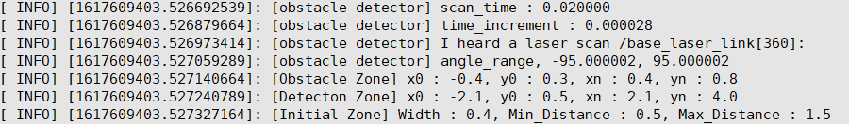





scan_time : time between scans [seconds]
time_increment : time between measurements [seconds]
$$count= \frac{scan time}{time increment}$$
$$scan_{time} :0.02 [s]$$
$$unit degree:0.52777°$$
1.0
$$time increment :0.000028 \left[s\right]$$
$$count :360$$
0.667
$$−95°$$
$$95°$$
0.5
0.3333
0.25
0.1667

Slide 2

$$obstacle\max{distance}: 0.8 \left[m\right]$$
$$detect\max{distance }:4.0 \left[m\right]$$
$$obstacle width :− 0.4 \left[m\right]$$
$$obstacle width : 0.4 \left[m\right]$$
$$detect width :−2.1 \left[m\right]$$
$$detect width :2.1 \left[m\right]$$
$$obstacle\min{distance}: 0.3 \left[m\right]$$
$$detect\min{distance }:0.8 \left[m\right]$$

Slide 3
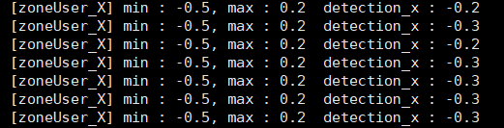


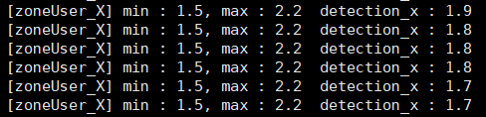
zone_user.min_point.x
zone_user.max_point.x

Slide 4
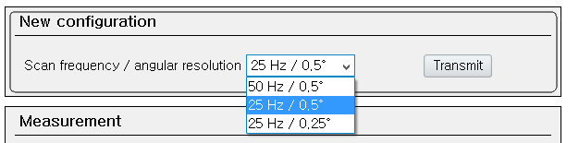
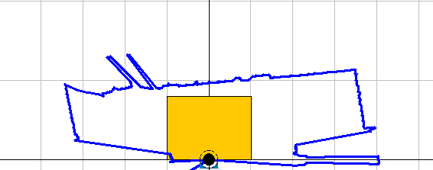
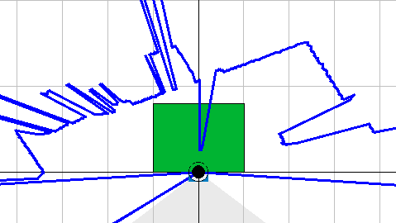
1. SOPAS Parameter
2. SICK -> Hokuyo
3. Tracker.cpp

Slide 5
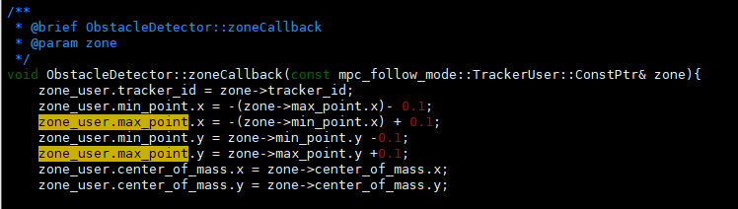
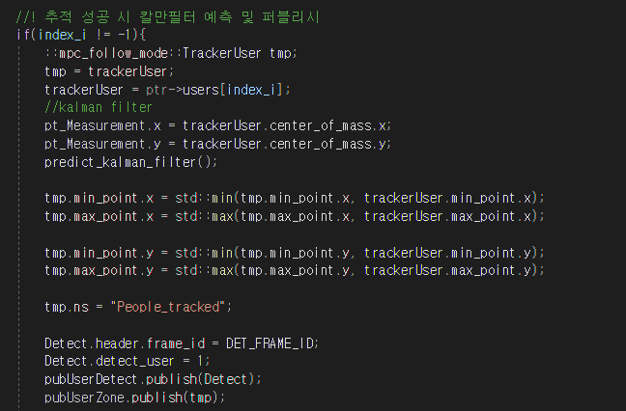
3. Tracker.cpp
zoneCallback
userArrayCallback

Slide 6
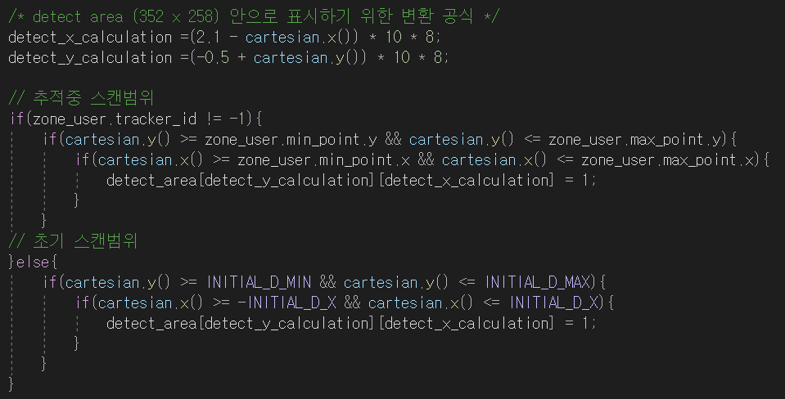
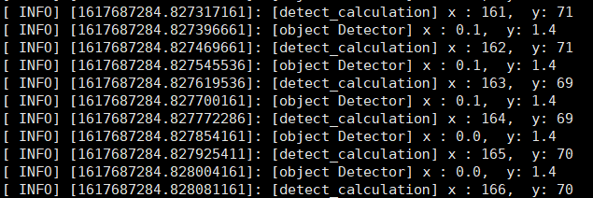
0 | 0 | 0 | 0 | 0
0 | 0 | 0 | 0 | 0
0 | 0 | 0 | 0 | 0
0 | 0 | 0 | 0 | 0
0 | 0 | 0 | 0 | 0
0 | 0 | 0 | 0 | 0
0 | 0 | 0 | 0 | 0
0 | 1 | 0 | 0 | 0
0 | 1 | 0 | 0 | 0
0 | 1 | 1 | 1 | 0
0 | 0 | 1 | 1 | 0
0 | 0 | 0 | 0 | 0

